Slide 1
DATA ANALYSIS
Call agent data analysis using power Bi Dax for measures and visualization
Babatunde-ajayi

Slide 2
Presentation’s schedule
Introduction
Key Performance Metrics
Trend and Pattern Analysis
Agent Performance Analysis
Result and Insight
Recommendation
Conclusion

Slide 3
Presentation’s schedule will be as follows
1 We will recap the overall project to give a high level understanding of the
business problem we're tackling and the specific requirements.
I will delve into the specific problem I've been focusing on, and provide some background on why it's such a significant issue.
After introducing the problem, I will outline my role in tackling this task and explain how I approached the solution.
4 I will then go over the high-level process that I followed to complete this
task, so that you have complete clarity in how i tackle these kinds of tasks.
5 Finally, I will go over the all important results and I will present them as a
series of insights and visualization's from my analysis.
To wrap up, I will summarize and open for any questions

Slide 4
Project recaps
Objective Analyze call center data to assess KPIs, trends, and agent performance, providing actionable insights for improving customer service and operations.
Data Overview: Focused on agent IDs, call times, topics, resolution status, speed of answer, talk duration, and customer satisfaction.
Key Insights:
- Faster response times lead to higher satisfaction.
- Technical support requires improved resolution rates.
- Agent performance identified top performers for mentoring.
Recommendations: Reduce response times, enhance technical support training, and improve satisfaction for payment queries through process changes.

Slide 5
Problem
The call center's primary issues are related to both efficiency and customer satisfaction. Key areas of concern include:
1. Customer Satisfaction Variability: Fluctuating satisfaction scores highlight inconsistency in service quality. Payment-related and technical support queries, in particular, have low satisfaction ratings, indicating potential gaps in agent knowledge or processes.
2. Resolution Rates: While certain topics like contract and admin support show higher resolution rates, technical support and payment issues frequently go unresolved. This may point to inadequate training or a lack of resources for resolving complex issues.
3. Inefficient Response Times: Long average speed of answer, particularly in peak periods, contributes to customer frustration. Calls often exceed acceptable response times, directly impacting satisfaction levels.
4. Agent Performance Discrepancies: There are significant variations in agent performance. While some agents like Stewart and Greg handle calls quickly and resolve issues, others struggle with longer talk times and lower resolution rates. This uneven performance affects overall efficiency.
5. Call Volume and Peak Times: High call volumes during certain times of day without adequate staffing lead to delays in response times and increased customer dissatisfaction.
The combined impact of these issues hinders overall operational performance and customer service quality, suggesting a need for targeted training, process optimization, and better resource management.

Slide 6
Process Data Understanding Data Cleaning Data Modelling Data Analysis Uncover Insight
1 Data understanding - the key to success on any data project is to understand
the data in detail. So we took the time to understand the data model and
domain of your business
2 Data cleaning - after understanding your business, we then cleaned the
available datasets and thought about what an ideal dataset should look like for
this problem.
3 Data modeling - After ensuring the data was clean for analysis, we needed
to process and model this data into a dataset that can precisely answer the
business questions and produce the results needed.
4 Data analysis - With our new dataset, we used our analytical expertise to
uncover insights from this dataset and to produce visualizations to describe the
insights.
5. And finally we used these insights to unlock business decisions and to make
recommendations on next steps.

Slide 7
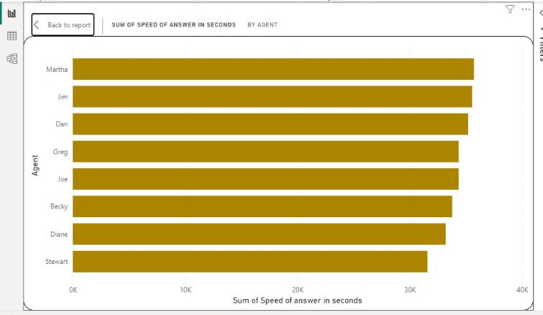
The sum of the speed of answer(in seconds) Stewart and Diane have the lowest total speed of answer, indicating they respond the fastest. - Martha and Jim have the highest, suggesting slower response times. Key Insight: - Stewart and Diane demonstrate superior response efficiency. - Martha and Jim could benefit from targeted training to improve their response times. Recommendation: - Focus on reducing response times, leveraging Stewart and Diane as benchmarks or mentors to enhance overall team performance.

Slide 8
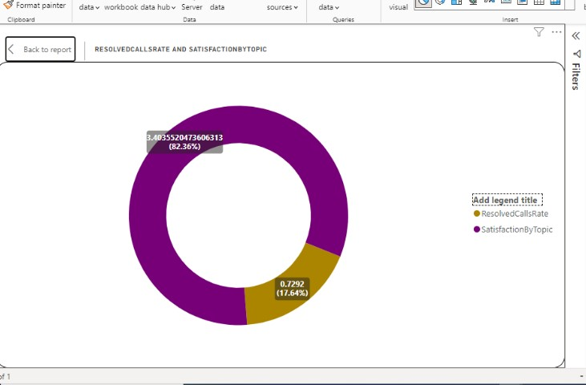
This donut chart compares Resolved Calls Rate (82.36%) with Satisfaction by Topic(17.64%). Key Insight: - A high call resolution rate (82.36%) is not proportionately reflected in customer satisfaction (17.64%).call topics or agent performance. Recommendation: - Investigate gaps between call resolution and satisfaction to identify areas where resolved calls may not be meeting customer expectations, possibly focusing on specific

Slide 9
Analysis: -Average Speed of Answered Calls: 67.52% indicates moderate efficiency. Faster response times can improve customer experience. - Overall Calls Answered: 4,050 calls were successfully handled, showcasing high call management capacity. - Overall Calls Not Answered:946 missed calls highlight room for improvement in agent availability or staffing during peak times. - Overall Customer Satisfaction: 3.90% is relatively low, pointing to potential issues in service quality or post-call handling despite a good answer rate. Recommendation: - Improve agent response time and minimize missed calls to boost satisfaction. - Investigate factors affecting satisfaction for targeted enhancements.
67.52% 4050 946
Average speed of answed call overall call answed overall call not answerd
3.40%
Overall customer satisfaction

Slide 10
Summary
This project focuses on analyzing call center performance data to enhance efficiency and customer satisfaction. Key metrics such as call resolution, speed of answer, and customer satisfaction were analyzed using Power BI to drive actionable insights.
Recommendations:
- Faster Response Times: Aim to reduce the speed of answer to under 30 seconds to enhance customer satisfaction.
- Enhanced Agent Training: Focus on areas with lower resolution, particularly technical support and payment queries.
- Optimized Staffing: Reevaluate staffing during peak call periods to address the high number of unanswered calls.
The analysis provided key insights to improve agent performance, streamline call handling processes, and boost overall customer satisfaction.

